Slide 1
CSC 735 – Data Analytics
Introduction

Slide 2
Brief History of Big Data
In early 2000s, search engine providers faced the challenge of Internet Scale Problems
Google and Yahoo! worked on possible solutions
In 2003, Google released a whitepaper titled "The Google File System" (GFS)
large clusters of commodity hardware
data is partitions into chunks
chunks are distributed and replicated to different nodes

Slide 3
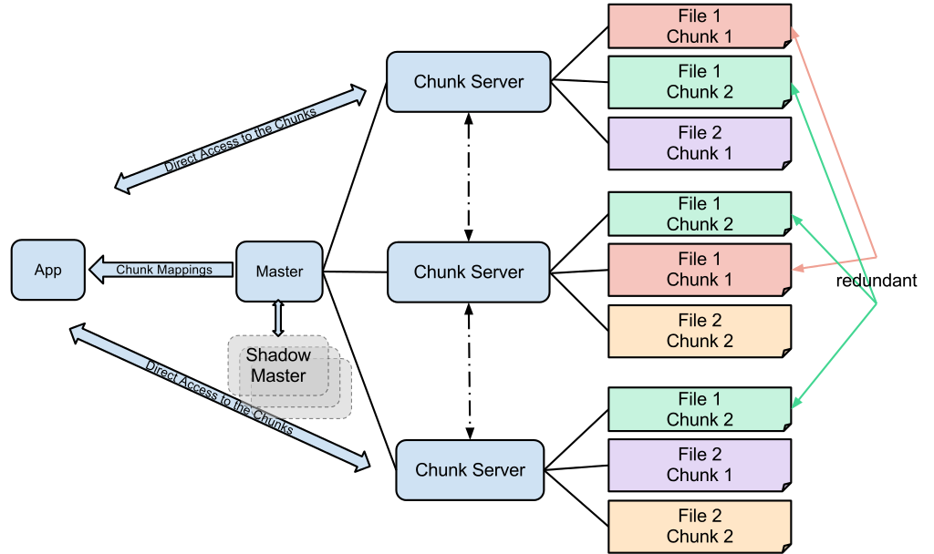
Google File System (GFS)

Slide 4
Brief History of Big Data (cont.)
In 2004, Google released another whitepaper, titled "MapReduce: Simplified Data Processing on Large Clusters."
These white papers inspired Doug Cutting and Mike Cafarella to develop Hadoop

Slide 5
What is Hadoop?
It is an Apache open source big data platforms
Processes large datasets across a cluster of commodity computers
It is written in Java
Scalable
Fault-tolerant

Slide 6
Hadoop Architecture
Hadoop consists of four modules
Hadoop Common: Java files and libraries necessary to start Hadoop and for supporting the other Hadoop modules
Hadoop Distributed File System (HDFS): distributed storage system with ideas similar to GFS
Hadoop YARN: A framework for job scheduling and cluster resource management
Hadoop MapReduce: A framework for parallel processing of large data sets.

Slide 7
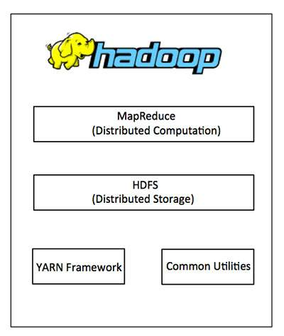
Hadoop Architecture

Slide 8
Big Data
Big data is essential for many organizations
Big data is growing exponentially

Slide 9
Rate of Data Growth
2.5 quintillion bytes of data created each day
90% of the data was generate in the last two years
Google processes more than 40,000 searches EVERY second (3.5 billion searches per day)!
77% of searches are conducted on Google
there are about 5 billion searches a day.

Slide 10
Rate of Data Growth (cont.)
Every minute:
Facebook users post 510,000 comments
456,000 tweets on Twitter
46,740 photos on Instagram
Users watch 4,146,600 YouTube videos
527,760 photos shared on Snapchat

Slide 11
Definition of Big Data
People define it in different ways
one definition relates to the volume of data
another definition relates to the richness of data
another definition is “too big” by traditional standards

Slide 12
Characteristics of Big Data
Three Vs of big data
Volume
Velocity
Variety
4th V
Veracity
5th V
Value

Slide 13
Units of Storage
Unit | Equivalent
1 kilobyte (KB) | 1,024 bytes
1 megabyte (MB) | 1,048,576 bytes
1 gigabyte (GB) | 1,073,741,824 bytes
1 terabyte (TB) | 1,099,511,627,776 bytes
1 petabytes (PB) | 1,024 TB
1 exabyte (EB) | 1,024 PB
1 zettabyte (ZB) | 1,024 EB

Slide 14
What is Apache Spark?
Unified computing engine and set of libraries for parallel data processing on computer clusters
Open source engine for big data
It support languages: Scala, Python, Java, and R
Has APIs for multiple analytics tasks such as: SQL, streaming, machine learning
It can run on a laptop and on a cluster of thousands of computers

Slide 15
What is Apache Spark? (cont.)
Unified
Computing engine
Set of libraries

Slide 16
Brief History
Research project at UC Berkeley AMPlab in 2009
Motivation
Initially batch applications
Then allowed interactive analysis and SQL queries
More APIs added over time: MLlib, Streaming, GraphX
In 2013, project contributed as open-source vender-independent to Apache Software Foundation
Databricks
Spark 1.0 in 2014 and 2.0 in 2016

Slide 17
Running Spark
You can download and install Spark on your computer
You need Java 1.8
Python if you plan to use Python
Instruction sheet on Blackboard
YouTube Video: Installing Apache Spark and Scala on Windows
Databrick’s Community Edition: free cloud environment for learning Spark
Create an account

Slide 18
Launching Spark’s Interactive Consoles
Launching the Python console
From Spark’s home directory, run .\bin\pyspark
Launching the Scala console
From Spark’s home directory, run .\bin\spark-shell

Slide 19
Using Databricks Community Edition
Hassle free environment for using Spark
Has all the data used by our book
Provides a notebook experience for using Spark
Basic overview
Book’s GitHub page

Slide 20
Hadoop MapReduce vs Spark
Spark is faster
Hadoop stores data on disk
Spark keeps as much data in memory as possible
Spark provides much more functionality
Hadoop only uses Map & Reduce
Spark uses most functional programming
Spark
Easier to use
REPL & interactive environment

Slide 21
Why Scala?
A language such as R or MATLAB does not scale
With Scala, it's easier to scale your problem to large datasets
Spark's APIs are modeled after Scala's collections, which mean distributed computations in Spark are simple to write in Scala

